Slide 1

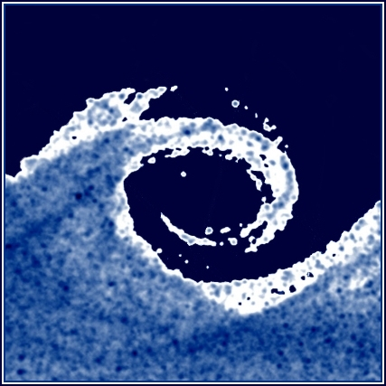

Budapesti University of Technology and Economics
Department of Fluid Mechanics
www.ara.bme.hu
Pre-measurement class I.
Esztella BALLA, PhD balla@ara.bme.hu
If you have any questions, contact me!
2021
Notes:
1

Slide 2
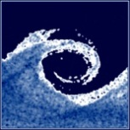
General information
Dear BME Citizen!
After nearly one and a half years, we finally have the opportunity for an entirely in-person education and meeting of students and instructors. An essential condition for safe, low-risk, in-person education is that all colleagues have adequate protection against the new coronavirus. In favor of the mutual responsibility and the defense of human health and life, we ask everyone to take the opportunity of vaccination, help the safe, in-person education. According to the forecasts with the appearance of the fourth wave, epidemiological restrictions are planned. Early vaccination is vital to maintain in-person education and be able to provide access to it to everyone.
(Own translation of University communique)
Notes:
2

Slide 3
General information
Department webpage: www.ara.bme.hu
Student information page: www.edu.gpk.bme.hu
(test scores, report and presentation upload etc.)
Subject webpage: http://www.ara.bme.hu/neptun/BMEGEATAG11/ENGLISH_course/
http://www.ara.bme.hu/neptun/BMEGEATBG11/ENGLISH_course/
http://www.ara.bme.hu/neptun/BMEGEATBM11/ENGLISH-course/
Laboratory webpage (materials, control tools): www.ara.bme.hu/lab
Schedule
  1. occasion (2nd week): general info, measurement uncertainty
  2. occasion (4th week): measurement equipment, methods
  3. occasion (6th week): presentation of the measurents + lab test (online)
  4. occasion (8th week): measurement A
  5. occasion (10th week): measurement B
  6. occasion (12th week): retake of the mesurements (if needed)
  7. occasion (14th week): presentations of measurements A and B
Notes:
3

Slide 4
General information
Measurement groups:
  4 people
  2-2 measurement leaders for the 2 measurement occasions (A,B), the other 2 are assisting
  The leaders prepare one report and one presentation for their measurement (same number of points will be given for the 2 people)
  For each measurement a subtask is assigned. The members of the groups and the subtasks will be on the webpage
Group # | Name | Neptun |  | Meas. Nr. | Task
1 | Chris Hemsworth | ABC123 | Leaders of meas. A | M12 | C
 | Scarlett Johansson | BAC231
 | Margot Robbie | CAB321 | Leaders of meas. B | M10 | D
 | Keanu Reeves | BCA213
Notes:
4

Slide 5
Preparing for the laboratory measurements
In preparing for the laboratory measurements, all members of the measurement group must read the syllabus (downloadable from the webpage: www.ara.bme.hu/lab) and understand the measurement which is to be made.
A hand written outline of the measurement needs to be prepared by the leaders until the beginning of the measurement. This outline should contain the following:
  The measurement group’s information (names, neptun codes), leaving a space for checking attendance
  Space where the measurement supervisor can sign each page
  A list of the instruments which will be used during the measurement, leaving room for the serial numbers, which will be documented during the measurement
  Tables for documenting the measured and calculated values, including atmospheric conditions (e.g. atmospheric pressure and temperature, etc.)
  The equations which are necessary in order to complete the measurement and the associated calculations, leaving room for verification calculations
  Millimeter paper needs to be brought to the laboratory measurements
Notes:
5

Slide 6
During the laboratory measurement
At the beginning of the laboratory the hand written outline will be checked by the instructor supervising the measurement, and questions will be asked in order to determine whether the group is prepared for the measurement. Unprepared groups will have to repeat the measurement.
The measurements need to be completed during the allotted time.
The proper calibration of the digital manometer needs to be assessed during the laboratory measurement, with the help of the Betz micro manometer.
During the measurement, department personnel supervising the measurements will assign a task to each group. The task will be to draw a graph of some measured values on the millimeter paper, in order to check the correctness of the measurement and the understanding of the measured results.
Notes:
6

Slide 7
After the laboratory measurement
A measurement report must be produced from the measured data
Laboratory calculations must be checked utilizing the departments online evaluation tools.
www.ara.bme.hu/lab
  Use of the control tools is mandatory. The control tools only evaluate whether the equations were applied properly.
    There is no limit as to the number of attempts which can be made, but the attempts are logged, and can be taken into account when giving grades. (fair use policy)
    In previous semesters each measurement had students who were able to complete the calculations correctly upon their first attempt.
  Once the calculations are correct, a code is provided to the student.
    This code must be included on the laboratory report cover.
    The number of attempts, and the calculation error [%], as compared to the expected calculated value, will be taken into consideration when grades are assigned.
Notes:
7

Slide 8

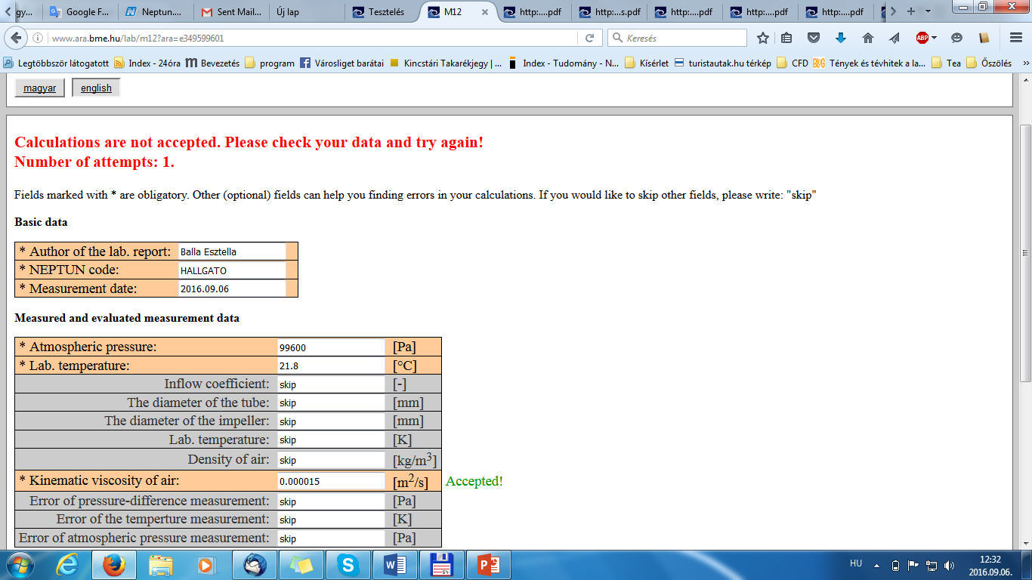
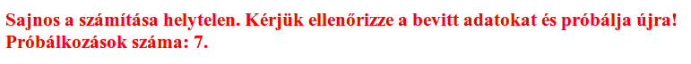
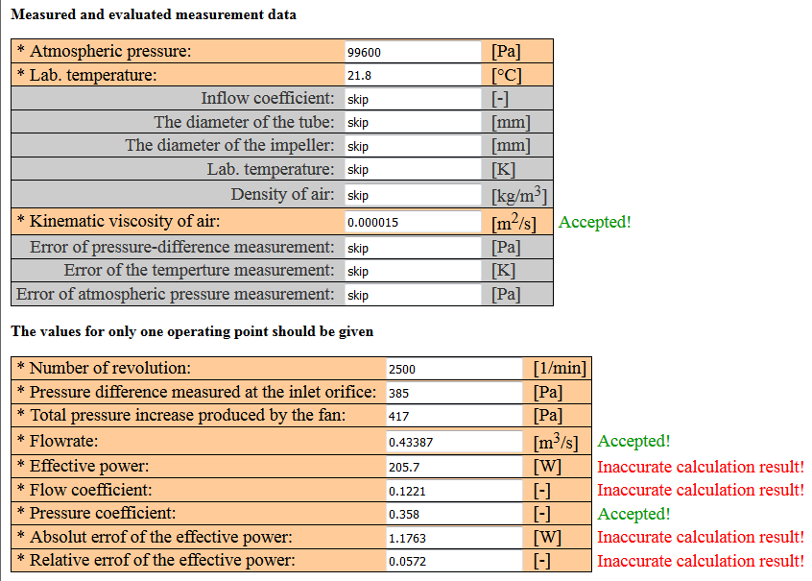
After the laboratory measurement
Example:
It is not mandatory to fill out the grey cells..
If the program deems the calculations incorrect, then it might be useful to fill out these cells, in order to help one find the source of the error.

Slide 9
After the laboratory measurement
After the calculations are accepted, the reports must be submitted through the Faculty moodle: www.edu.gpk.bme.hu
Reports must be submitted by midnight of the 2nd Sunday following the measurement
Consultations:
  The faculty members grading the reports will provide consultation opportunities for each measurement they are grading. You can ask for consultation in email.
  The name of the instructor responsible for each measurement can be gound on the website: www.ara.bme.hu/lab
Notes:
9

Slide 10
After the laboratory measurement
Requirements of laboratory reports (can aslo be found at www.ara.bme.hu/lab)
  The cover of the laboratory report must be downloaded from the web site.
  The lab report can only be 8 pages long plus the required report cover and mandatory annex
  The report should contain the following:
    Code (proving that the calculations are right) on the cover
    Short description of the measurement, data of the measurement device
    The subtask
    Equations
    The measured and calculated data in tables
    Uncertainty calculations
    Necessary diagrams with error bars
    Interpretation of the measurement results
    Bibliography
    The hand-written measurement plan, filled in during the measurement as an annex (in scanned form)
Notes:
10

Slide 11
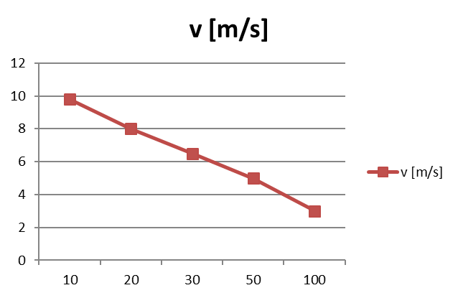
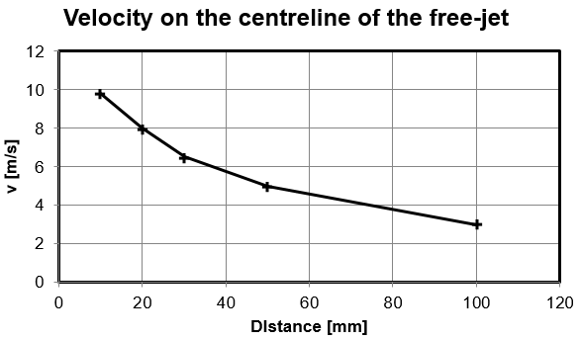
After the laboratory measurement
Beside the report the Excel file containing the calculations should also be submitted
The type of the diagrams should be XY plot, use of the line plot is FORBIDDEN! (the distance on the X axis will not be proportional)
  Incorrect (and ugly)
  (the values on the X axis are only labels)
  Correct
  (the values on the X axis are numbers)
Notes:
11

Slide 12
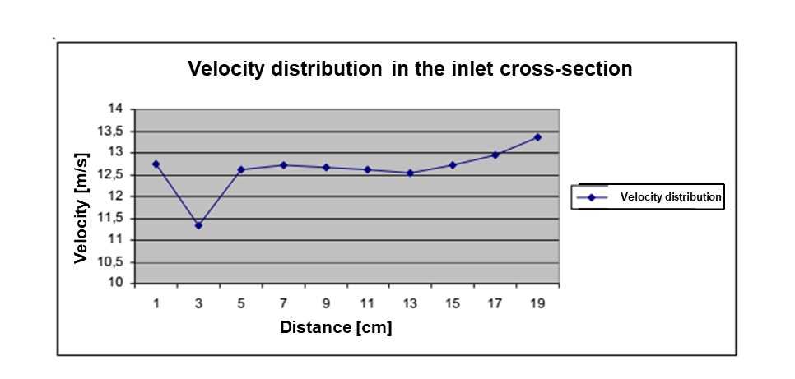
After the laboratory measurement
Incorrect (and ugly) diagram
Unnecessary legend, thus the diagram is small
The coloring of the curve is unnecessary
Why is the background gray?
The border is unnecessary
Bad diagram type
There are no errorbars
Notes:
12

Slide 13
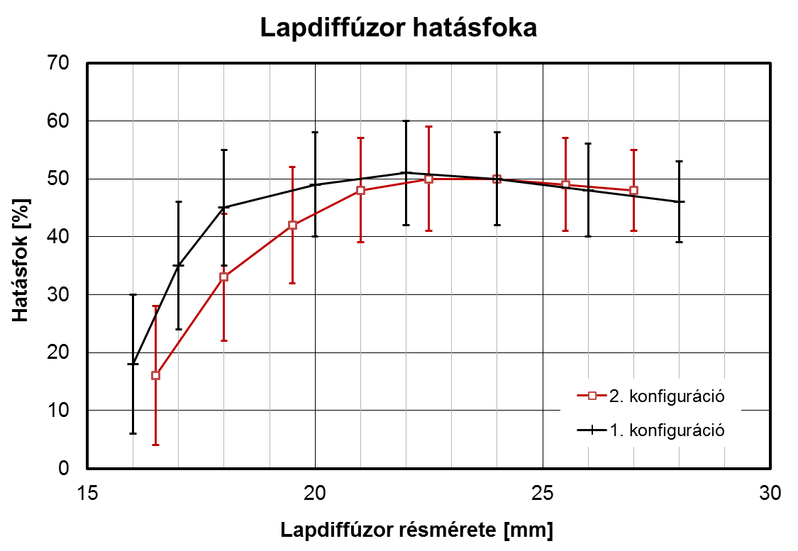
After the laboratory measurement
Nice diagram
Title
(not necessary, instead caption can be used at the bottom)
Boundary: 1.5-2 pt, grid lines: 0.5 pt.
Efficiency of the sheet diffuser
Axis name and [dimension]
Readable letter size
Efficiency [%]
Minimal number of conrasting colors
Error bars
2. configuration
1. configuration
Meaningful legend
Gap size of the sheet diffuser [mm]
Figure 3. The efficiency of the sheet diffuser as a funcion of gap size for the two measured configurations
The axis starts from 0
(not autoscale)
The diagram is not miniature, it utilizes well the width of the page
Points connected with sraight lines
(We are indicating that they belong together, and not an interpolation between them. Not even necessary.)
Notes:
13

Slide 14
After the laboratory measurement
The report should be logical and „nice”
  Justified form
  Equations are created with the equation editor and not copied in as a picture
  Diagrams are uniform
  Hand made figures should be avoided (use: photos, CAD softwares…)
The file extension of the report should be PDF
A mandatory annex to the 8 pages needs to contain the following:
    A scanned copy of the hand written notes which were signed upon completion of the laboratory measurement, and which contain all the tables of all the data which was recorded.
The uploaded zip file must contain an excel file in which the calculations were made, and the pdf of the laboratory report
The name of the file should be in the following form:
  Lastname1_neptun1_lastname2_neptun2_Mx_deadline.zip
  Example: Hemsworth_ABC123_Johansson_BAC231_M12C_2021107.zip
Notes:
14

Slide 15
After the laboratory measurement
ALL LABORATORY REPORTS NEED TO BE ORIGINAL AND MADE BY THE LAB GROUP! ANY GROUP SUBMITTING WORK WHICH WAS NOT SOLELY PRODUCED BY THE GROUP, WITHOUT CITING THE APPROPRIATE SOURCE, WILL BE REPORTED TO THE DEAN’S OFFICE AND THE ETHICS COMMITTEE IN ACCORDANCE WITH THE CODE OF STUDIES (CoS/TVSZ)
The deadline for the submition of the report is midnight of the 2nd Sunday following the measurement
The reports are evaluated within 2 working days, and a message is sent to the student through moodle informing the student whether the report was accepted or not. If the report is unacceptable, there is one opportunity to resubmit the report by the following Sunday at midnight, however in this case you can only receive the 80% of the maximal points.
The report is accepted if the received points reach the 40% of the maximal points
The accepted report can also be improved once for better points until next Sunday
An accepted report is a criterion for the presentation (info will be provided later)
Notes:
15

Slide 16
Late submission and make up
Sanctions for late submission
  -20%
  Extra fee will be charged
  The report must be submitted by Friday 4 pm on the 14th week! (this is very severe delay)
Retake of the lab test:
  3 chance
  Re-retake: oral (you have to contact your seminar instructor)
Late presentation:
  During the „repeat exam period”
  Additional fee
Notes:
16

Slide 17
Presentation (more info later)
The template for the presentations, which is also an example for a typical presentation, can be downloaded from the webpage.
You may use the departmental template, but don’t need to
8 minutes
The measurement has to be summarized.
The personal measurement assignment has to be presented and explained.
The measurement set-up and the used equipment has to be presented.
Error calculations has to be presented.
The evaluation of the results has to be presented.
The results have to be shown
The conclusions and results have to be summarized.
(Suggestions for hte improvement of the measurement)
Try to make it unique and interesting!
Notes:
17

Slide 18
Checklist
At the measurement:
In preparing for the measurement (hand written measurement plan): assignment, neptun code, name, documentation, personal assignment, mm paper, signature.
The laboratory instructor checks your preparedness with 1 or 2 questions
Record atmospheric conditions (p₀, T₀) before and after the laboratory
Calibrate to the Betz micro manometer
You can ask questions from any of the laboratory instructors at the laboratory session, but it is advised to ask from the one leading your measurement
Check the list of supplies in your measurements box. The box will be opened and closed by the laboratory instructor. The laboratory instructor will provide manometers, and will replace those which needs to be charged. Do not connect digital manometers to chargers!
After the measurement
Consultations can be made with the appropriate instructor during consultation hours.
Calculation results have to be checked www.ara.bme.hu/lab
Once calculations are correct and the report is complete, submit the report: www.edu.gpk.bme.hu (pdf+xls)
  zip name = Lastname1_neptun1_lastname2_neptun2_lastname3_neptun3_Mx_deadline.zip
Notes:
18

Slide 19



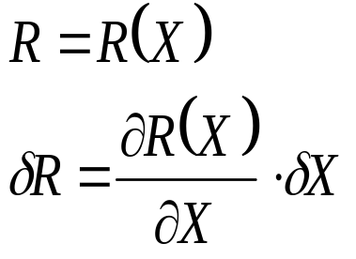
Determining the uncertainty of the results (error calculation) I.
Absolute error (measurement uncertainty): the region where the measurement data is located with 95% confidence
Notation if the measured data is X:
The correct specification of the measurement data in this case:
Relative error:
In case of a calculated quantity (R) the error propagates, and the following equation is used:

Slide 20
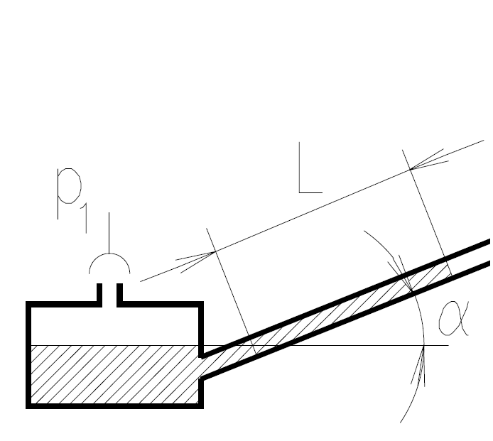

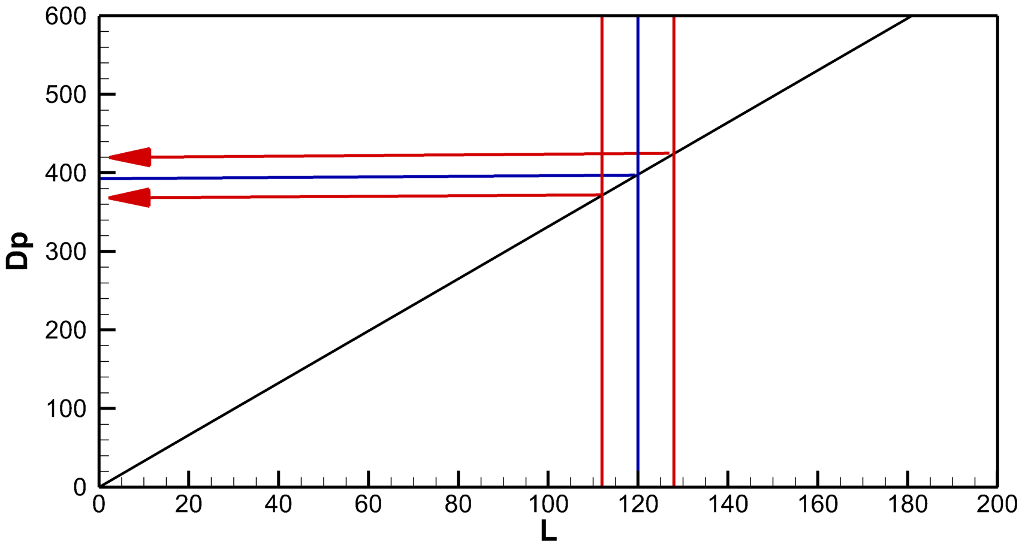




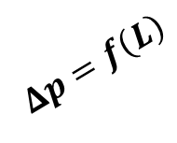





Example
Measurement uncertainty of an inclined manometer
Δp
$$∆p=ρ∙g∙L∙sin(α)$$
L
$$δ\left(Δp\right)=\frac{∂p}{∂L}∙δL$$
$$δL=±8mm$$
α
$$δ\left(Δp\right)=?$$
ρ=800 kg/m³, α = 25°
Slope:
$$δ\left(Δp\right)$$
$$δ\left(Δp\right)$$
$$\frac{∂p}{∂L}$$
$$Δp=f\left(L\right)$$
$$δL$$
$$δL$$

Slide 21
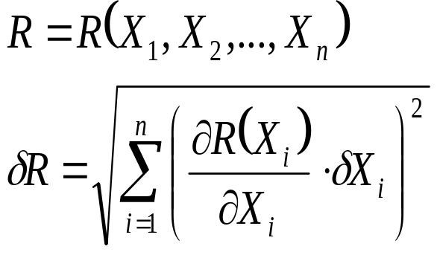
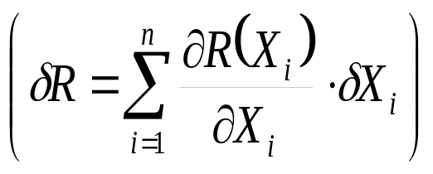
Multiple measured quantity
In case of more, independently measured variables :
Why aren’t we taking the sum of the errors?
Because the errors are random, they can be smaller and larger than the expected value. Thus, they can both increase and decrease the value of the calculated quantity. Consequently, the resulting error (caused by mutiple measured quantities with errors) will be smaller than the sum of the errors caused by the individually measured quantities.
(incorrect)

Slide 22
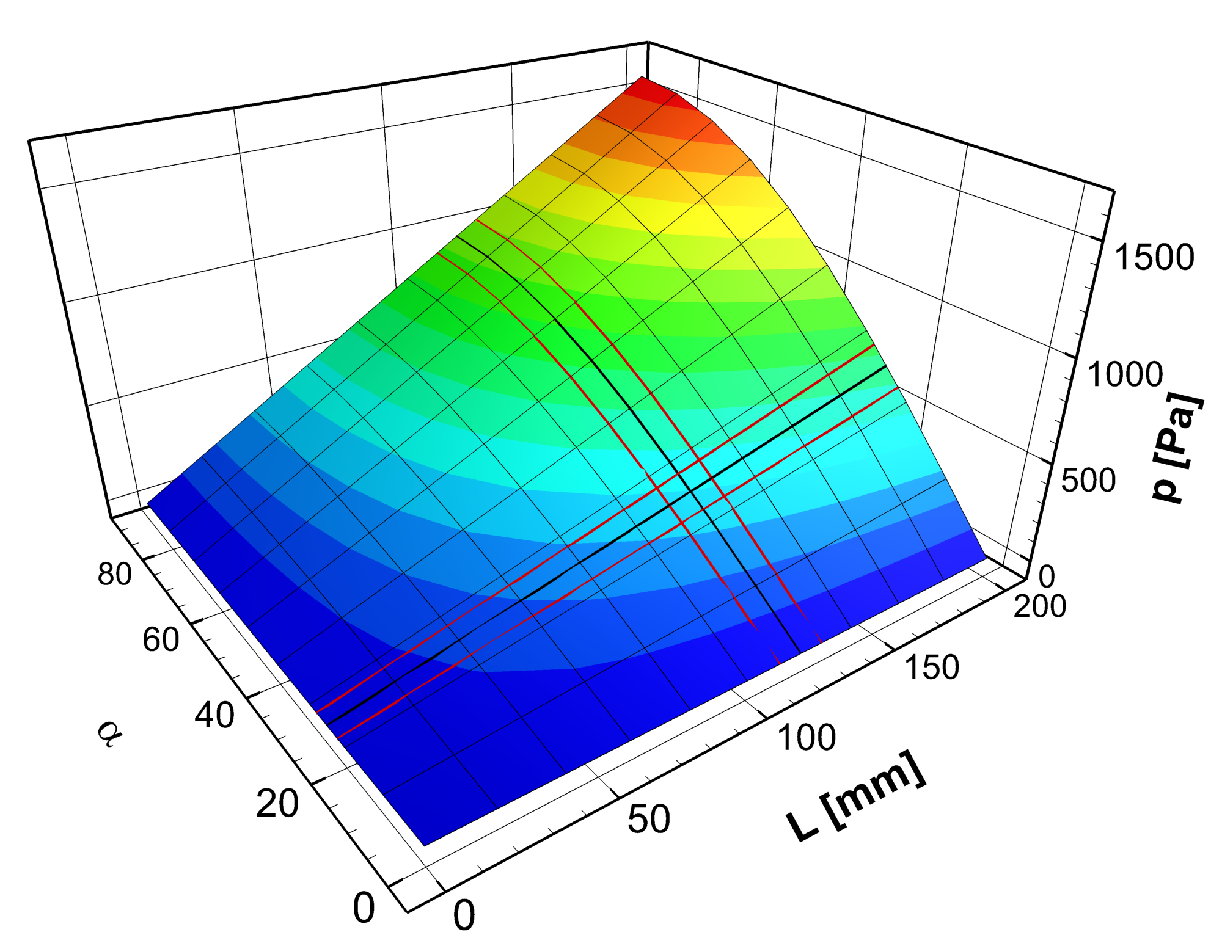









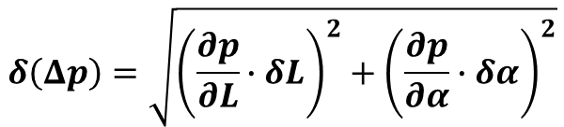

Example
Measurement uncertainty of an inclined manometer
$$∆p=ρ∙g∙L∙sin(α)$$
$$δ\left(Δp\right)=\sqrt{{\left(\frac{∂p}{∂L}∙δL\right)}^{2}+{\left(\frac{∂p}{∂α}∙δα\right)}^{2}}$$
$$δL=±8mm$$
$$δα=±3°$$
Slope:
$$δ\left(Δp\right)=?$$
$$\frac{∂p}{∂L}$$
ρ = 800 kg/m³,
L = 120 mm
α = 25°
$$δL$$
$$δL$$
Slope:
$$\frac{∂p}{∂α}$$
$$Δp=f\left(L, α\right)$$
$$δα$$
$$δα$$

Slide 23
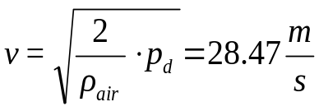
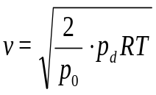

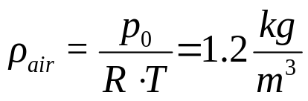
Determining the uncertainty of the results (error calculation) II.
Example: Velocity measurement uncertainty
Dynamic pressure measured using a Pitot-static (Prandtl) tube:
p_{d} =486.2Pa
Atmospheric conditions experienced in the lab:
p₀ =1010hPa ; T=20°C (293K);
Specific gas constant of air
R=287 J/kg/K
Quantities having uncertainties (X_{i}):
-The measurement uncertainty of the atmospheric pressure
comes from the error arising when reading the scale: δp₀=100Pa
- The measurement uncertainty of the atmospheric temperature
in the lab: δT=1K
- The pressure measurement uncertainty arising when making a
measurement using a Pitot-static (Prandtl) probe and a EMB-0XY digital manometer: δ p_{d}=2Pa
More info: Vad & Lukács, Advanced Flow Measurements lecture note, Chapter 2.3 Dynamic pressure
Notes:
23

Slide 24
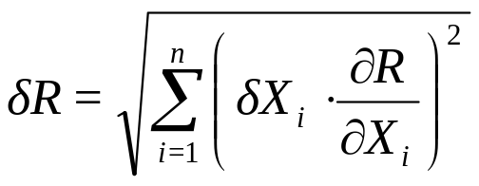
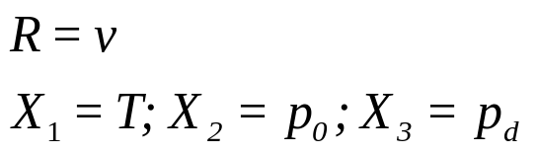
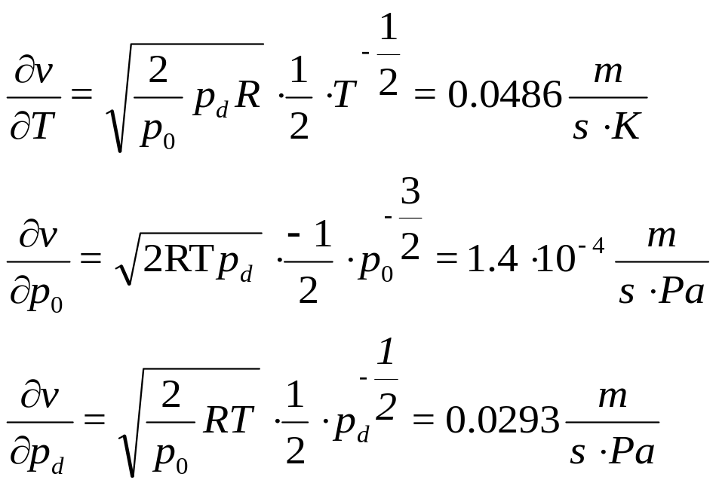
Determining the uncertainty of the results (error calculation) III.
Example: Velocity measurement uncertainty
Typical calculation of absolute error:
Notes:
24

Slide 25
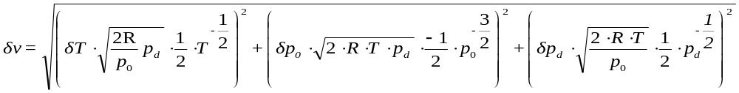
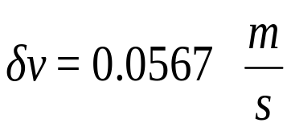
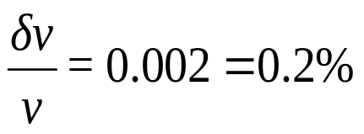
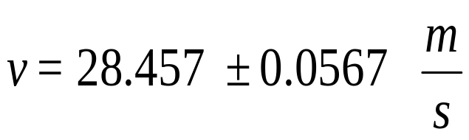
Determining the uncertainty of the results (error calculation) IV.
Example: Velocity measurement uncertainty
The absolute uncertainty of the velocity measurement:
The relative uncertainty of the velocity measurement:
The result of the velocity measurement:
Notes:
25

