Slide 1

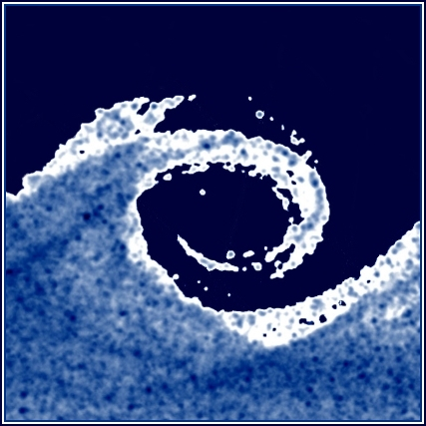

Budapesti University of Technology and Economics
Department of Fluid Mechanics
Pre-measurement class II.
Esztella BALLA balla@ara.bme.hu
2021.
Notes:
1

Slide 2
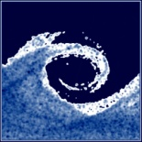
Summary of the measurement process
Successful measurement test
Download and read the measurement syllabus
Hand made measurement plan
Measurement (preparation, measurement plan, millimeter paper are necessary)
Prepare measurement report and excel file at home
Check if your calculations were correct
If the calculations are correct, upload the report and the excel (the deadline is the second Sunday midnight after the measurement)
Correct the report according to the comments
Prepare a presentation (if the report was accepted)
Upload the presentation (more info later)
Presentation

Slide 3

Measuring pressure differences (measuring Δp)
Provides the basis of many measurements (e.g. velocity, volume flow rate)
For a fluid medium, pressure differences can be measured between two points
It is often measured with regard to a reference value (atmospheric pressure, static pressure in a duct)
Measurement instruments
  U tube manometer
  Betz manometer
  Inclined micro manometer
  Bent tube micro manometer
  EMB-001 digital handheld manometer
Notes:
3

Slide 4

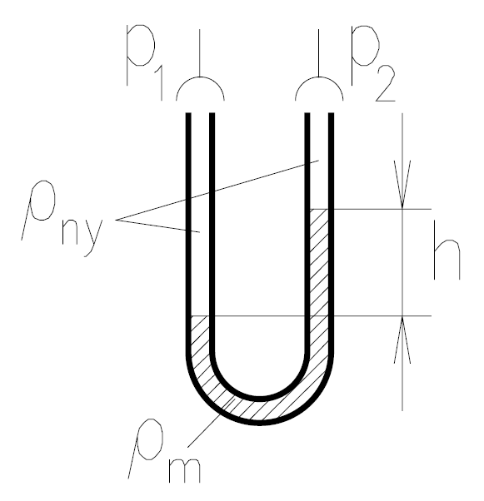



Measuring Δp / U tube manometer I.
Pipe flow
Butterfly valve
Average of the pressure measured on the pressure taps around the perimeter
The manometers balance equation:
H
g
>
More info: Spurk & Aksel, Fluid Mechanics, Chapter 5 Hydrostatics
Can be simplified if
ρ_{f} <<ρ_{m}
(e.g. if the measured fluid is air
and the measurement fluid is water)
ρ_{f}
Δ
p_{L}
p_{R}
Notice that
Notes:
4

Slide 5

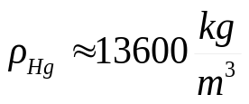
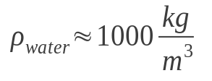
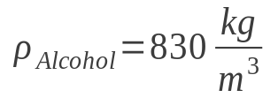
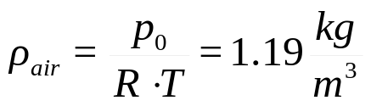
Measuring Δp / U tube manometer II.
The manometers balance equation:
Density of the measuring fluid ρ_{m} (approximately)
ρ_{f}
mercury
Δ
water
alcohol
Density of the measured fluid: ρ_{f} (For example air)
p₀ - atmospheric pressure [Pa] ~10⁵Pa
R - specific gas constant for air 287[J/kg/K]
T - atmospheric temperature [K] ~293K=20°C
Notes:
5

Slide 6



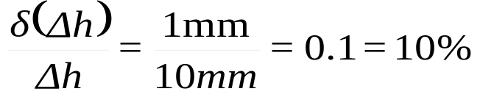
Measuring Δp / U tube manometer III.
Example: the reading:
The accuracy ~1mm: The absolute error:
How to write the correct value with the absolute error(!)
The relative error:
Disadvantages:
Reading error (twice)
Accuracy~1mm
For a small pressure difference, the relative error is large
Advantages:
Reliable
Does not require maintenance
Notes:
6

Slide 7
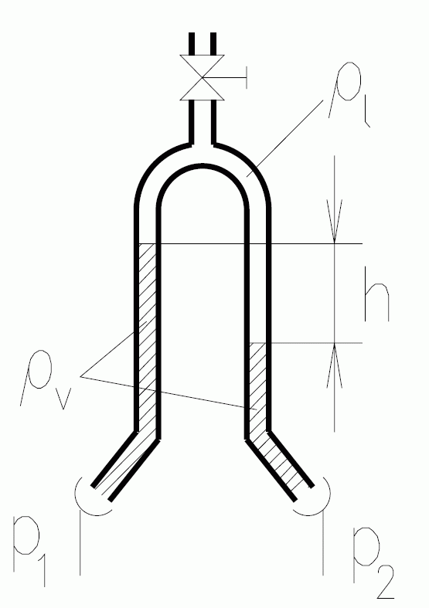
Measuring Δp / upside down U tube micro manometer
The manometer’s balance equation
ρ_{a}
Since in most cases upside down U tube manometers are used to measure liquid (e.g. water) filled lines, the measurement fluid is usually air, and the density ratio is therefore (1.2/1000). -ρ_{a} (density of air) can be neglected.
The advantage of this measuring device is that when it is used for liquid filled systems, air can be used instead of mercury in order to improve the accuracy of the relative error of the readings!
ρ_{w}
Notes:
7

Slide 8
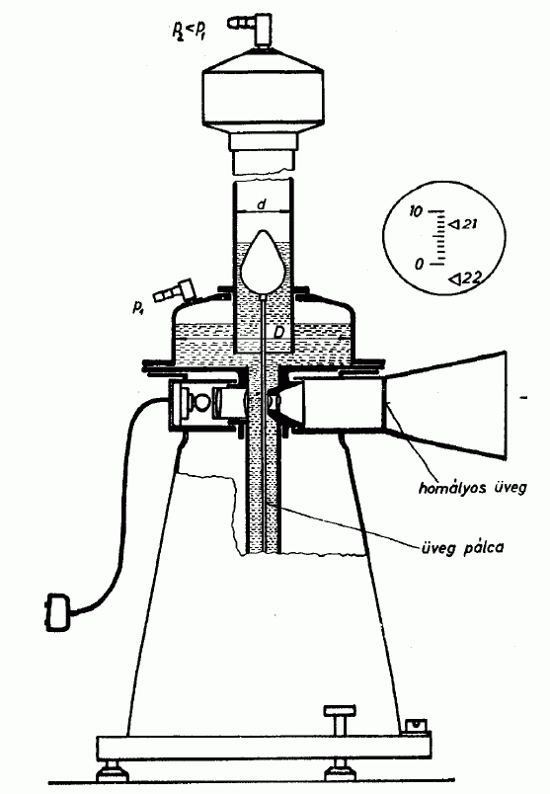

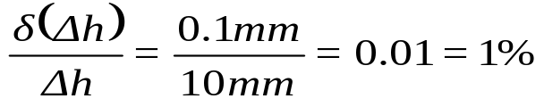
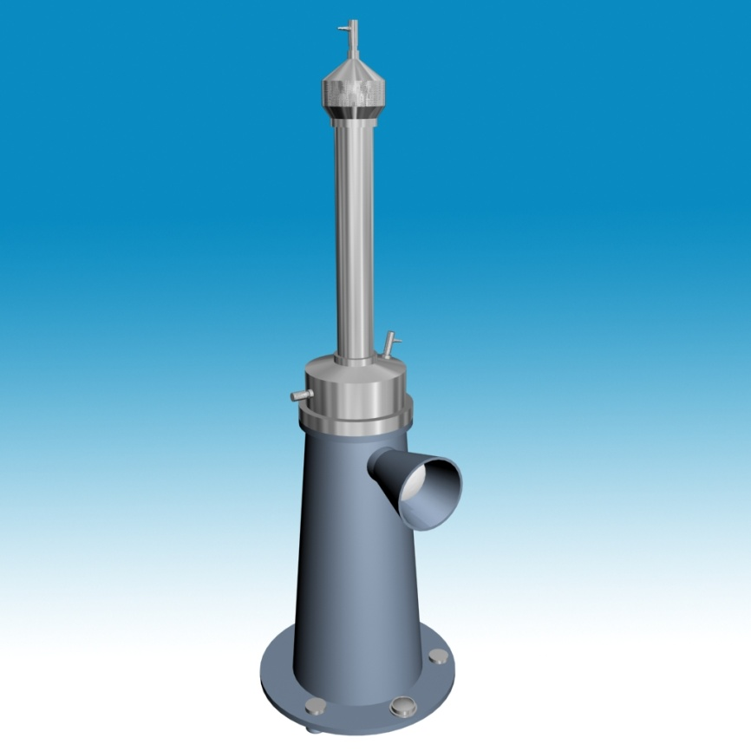
Measuring Δp / Betz micro manometer
The relative error is reduced by optical means, improving the accuracy.
Accuracy ~0,1mm: The absolute error is:
The relative error:
Notes:
8

Slide 9
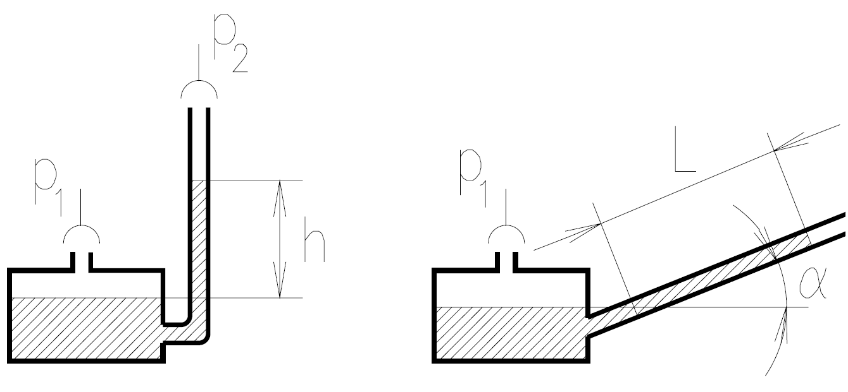


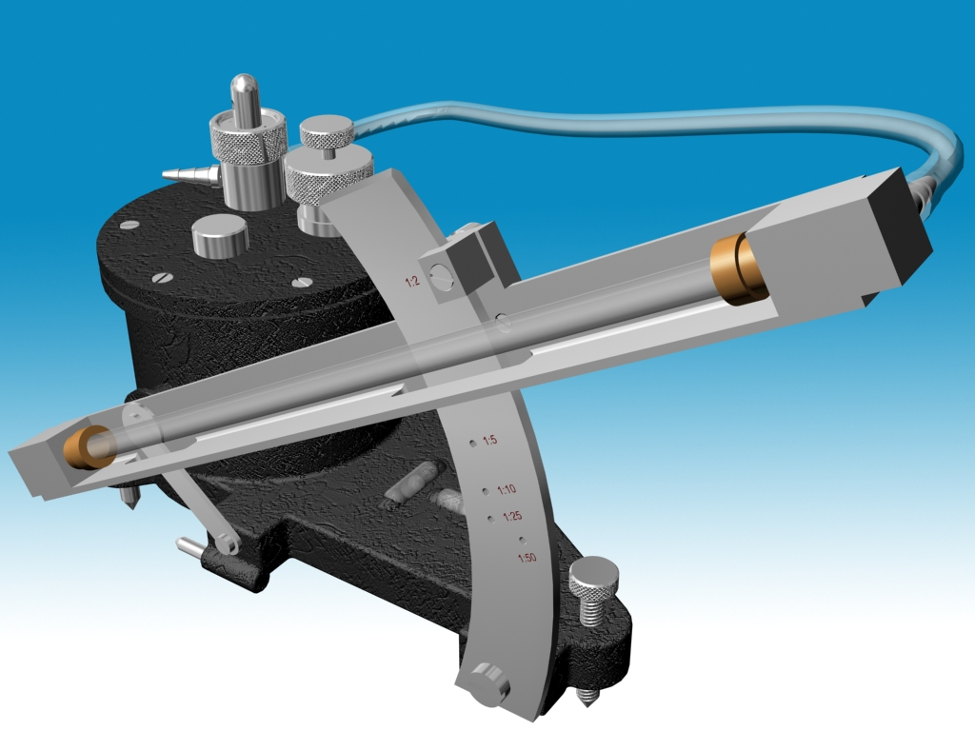
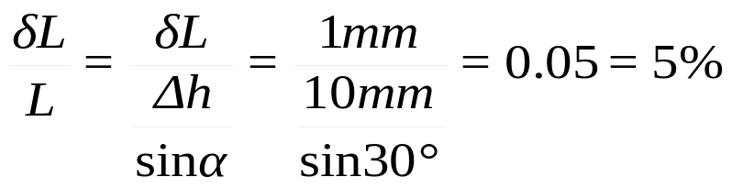
Measuring Δp / inclined micro manometer
The manometers balance equation
Δ
Accuracy: δL~±1mm,
Relative error in the case of α=30°
The relative error is a function of the inclination angle - f(α) - It is characterized by a changing relative error.
Notes:
9

Slide 10
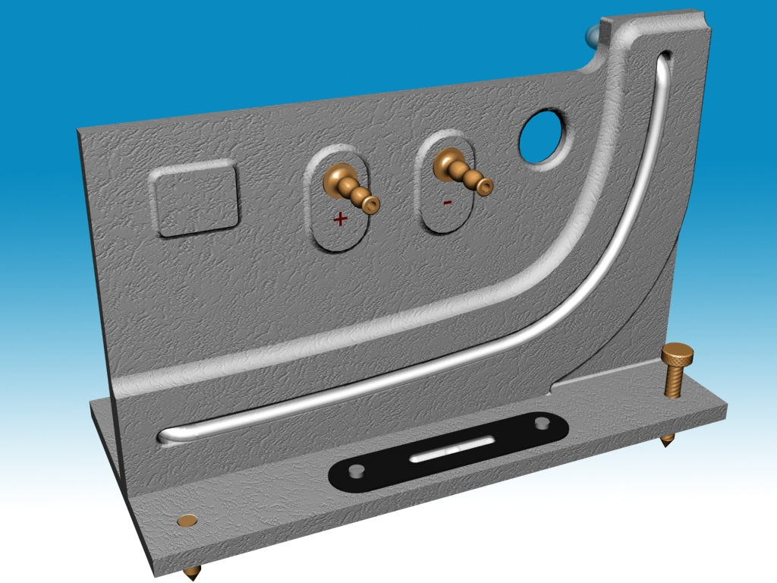
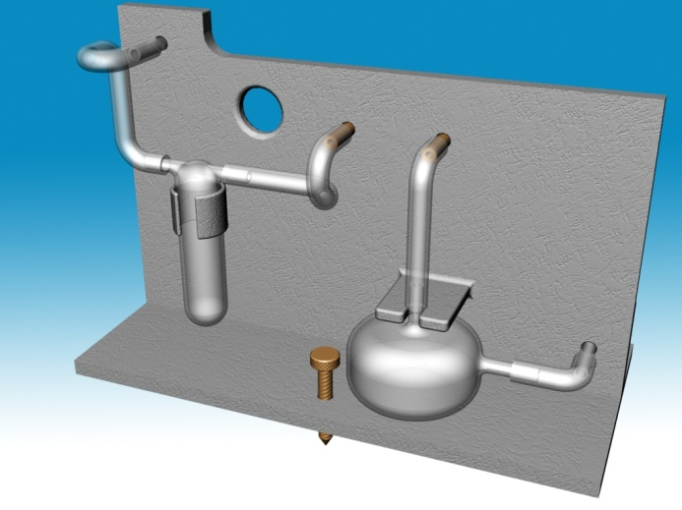
Measuring Δp / bent tube micro manometer
Is characterized by a constant relative error and a nonlinear scale
Notes:
10

Slide 11
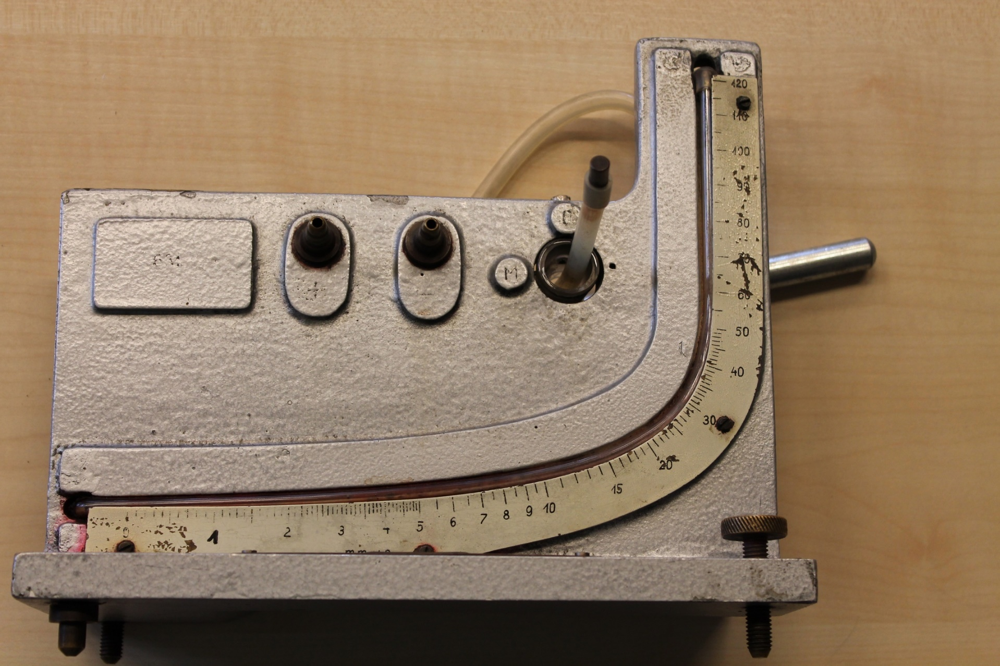
Measuring Δp / bent tube micro manometer
Is characterized by a constant relative error and a nonlinear scale
2009.
tavasz

Slide 12
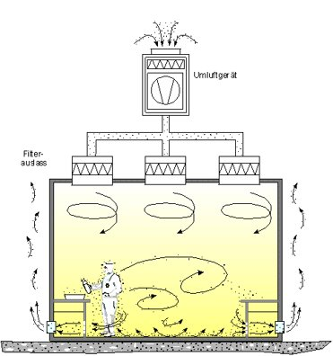
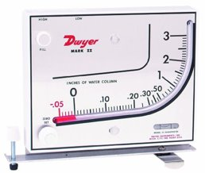
Measuring Δp / bent tube micro manometer
Where do they still use tube manometers?
Cleanrooms: designed to maintain extremely low levels of particulates, such as dust, airborne organisms, or vaporised particles. Overpressure of about 5-50 Pa.
It is easy to monitor with a tube manometer
2009.
tavasz

Slide 13

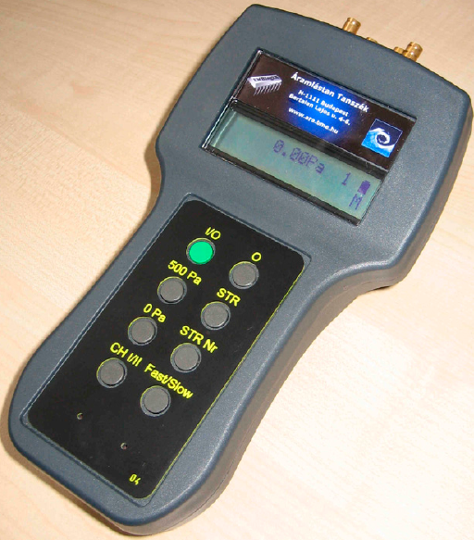

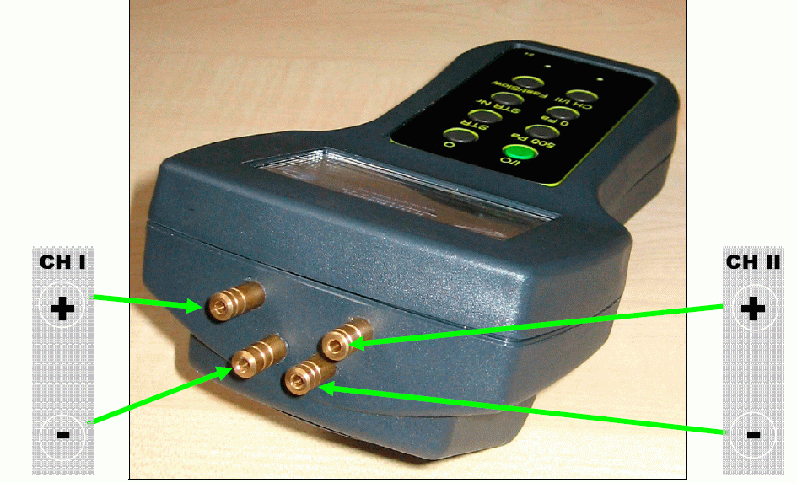
Measuring Δp / EMB-001 digital manometer
List of buttons to be used during the measurements
On/Off Green button
Factory reset „0” followed by the „STR Nr
Changing the channel „CH I/II”
Setting 0 Pa „0 Pa”
Averaging time(1/3/15s) „Fast/Medium/Slow” (F/M/S)
Measurement range:
Measurement error:
Notes:
13

Slide 14
Measuring Δp / EMB-001 digital manometer
Calibration of the EMB-001 digital manometer (obligatory!):
The digital manometer is compared to a more accurate instrument: the Betz micro manometer
A regression line will be used for the calibration
This can be done by a linear trend line in Excel. The values measured with the digital manometer should be on the horizontal axis, and the values measured with the Betz should be on the vertical axis. Both should be in Pa dimension.
The accurate measurement values can be determined from the values measured with the digital manometer using the regression line.

Slide 15
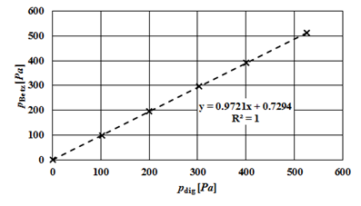
Measuring Δp / EMB-001 digital manometer
Calibration of the EMB-001 digital manometer: EXAMPLE
Environmental data:
Measured and calculated values:
t₀ [°C] | 25
T₀ [K] | 298.15
ρ_{w} [kg/m³] | 997.1
g [N/kg] | 9.81
p_{dig} [Pa] | p_{Betz} [w.c.mm] | p_{Betz} [Pa]
0 | 0.0 | 0.0
102 | 10.2 | 99.8
200 | 20.0 | 195.6
303 | 30.3 | 296.4
401 | 40.0 | 390.8
526 | 52.3 | 511.1
The diagram:

Slide 16
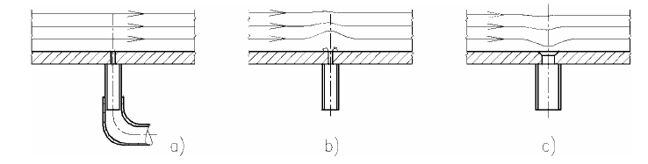
Measuring Δp / Pressure tap
When measuring pressures, we need the streamlines to be
parallel and straight
In this case the pressure is not changing perpendicularly
to the streamlines
(The normal component of the Euler equation)
a) Correct b) c) Incorrect
More info: Vad & Lukács, Advanced Flow Measurements lecture note, Chapter 2.1 Static pressure
Spurk & Aksel, Fluid Mechanics, Chapter 4.2.1 Euler’s equation
Notes:
16

Slide 17
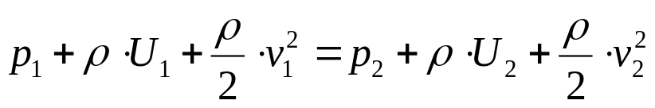
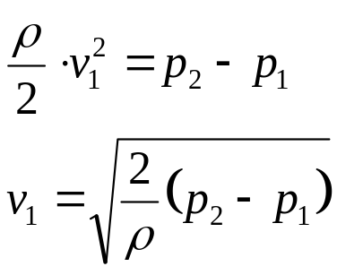
Velocity measurement devices
Pitot tube/probe
Pitot-static (Prandtl) tube/ probe
Theoretical background:
Simple form of the Bernoulli equation for lossless flow:
If U₁=U₂ and v₂=0:
More info: Vad & Lukács, Advanced Flow Measurements lecture note, Chapter 2.3 Dynamic pressure
Spurk & Aksel, Fluid Mechanics, Chapter 4.2.2 Bernoulli’s equation
Notes:
17

Slide 18
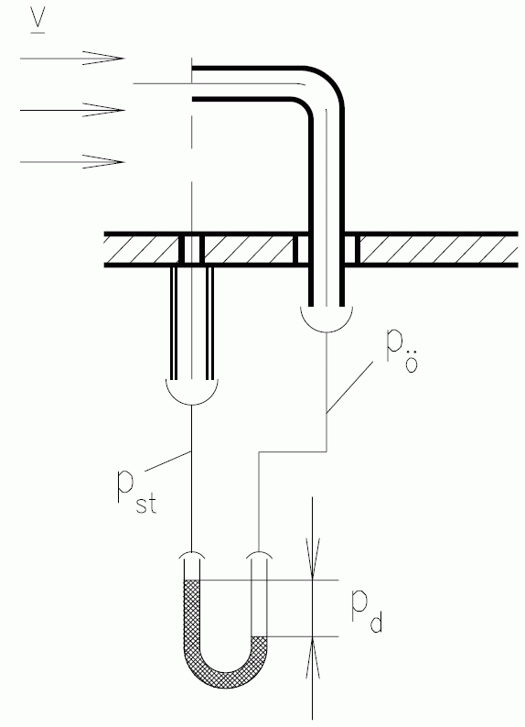
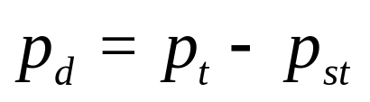
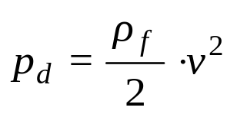
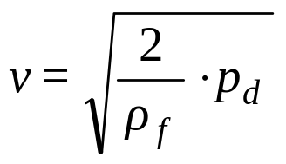
Velocity measurement / Pitot tube/probe
Pitot, Henri (1695-1771), French engineer.
Determining the dynamic pressure:
p_{t} the pressure of the stopped fluid (total pressure)
p_{st} the pressure acting on a surface which is parallel to the flow (static pressure)
Determining the velocity:
Notes:
18

Slide 19
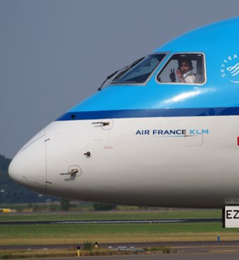
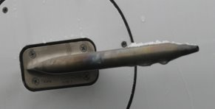
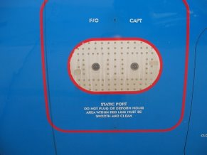
Velocity measurement / Pitot tube/probe
Still used on aeroplanes to determine its velocity compared to air
Separate static pressure ports are installed on the fuselage
Notes:
19

Slide 20
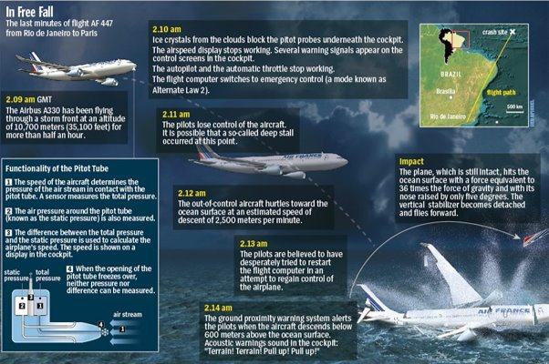
Velocity measurement / Pitot tube/probe
Tragedy of Air France 447
One of the reasons was the icing of the Pitot-tubes
Notes:
20

Slide 21
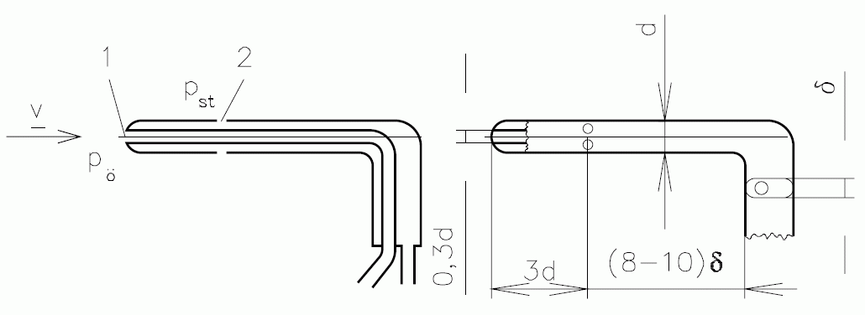
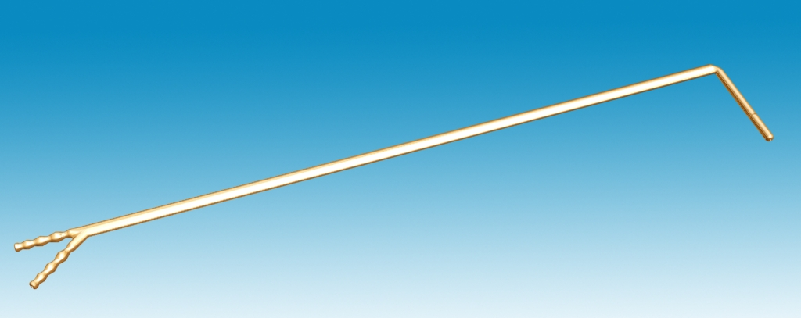
Velocity measurement / Pitot-static (Prandtl) tube/probe
Prandtl, Ludwig von (1875-1953), German fluid mechanics researcher
pt
Notes:
21

Slide 22
Measuring volume flow rate
Definition of volume flow rate: the volume of fluid which passes through a given surface per unit time. Usually it is the basis of accounting or system control
It is denoted by : q_{v}, its dimension is: volume / unit time (e.g..: m³/s)
Measurement method based on velocity measurements in multiple points
  Non-circular cross-sections
  Circular cross-sections
    10 point method
    6 point method
Pipe flow meters based on flow contraction
  Venturi flow meter (horizontal/inclined axis)
  Through flow orifice (contraction ratio, iteration)
  Inlet orifice
  Inlet bell mouth
More info: Vad & Lukács, Advanced Flow Measurements lecture note, Chapter 6.1 Volume flow rate deduced from velocity measurement data
Notes:
22

Slide 23
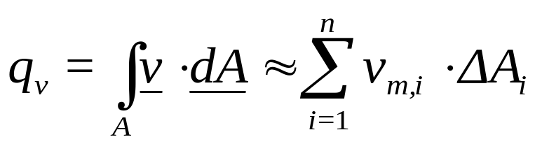
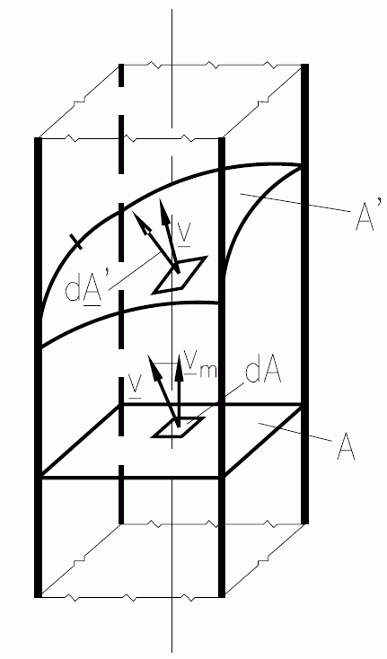
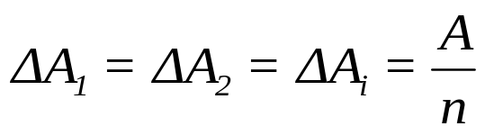
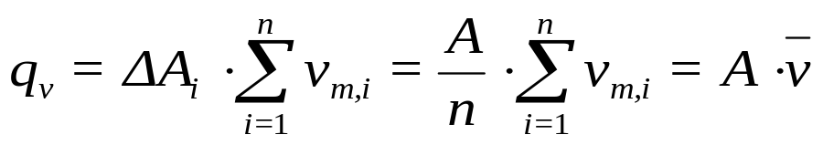




Volume flow rate / based on velocity measurements I.
Non-circular cross-sections
Assumptions:
1.
2.
3.
4.
Notes:
23

Slide 24
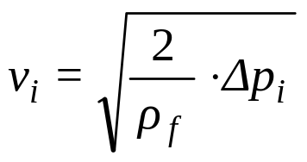
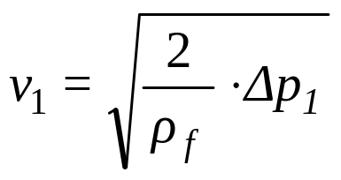
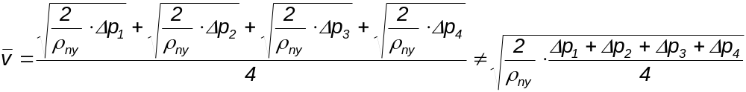
Calculating an average velocity from multiple velocity measurements
Very important: the square root of the averages ≠ the average of the square roots(!)
Example: Measuring the dynamic pressure in multiple points and calculating the velocity from it
1.
2.
3.
4.
Correct
Incorrect
Notes:
24

Slide 25
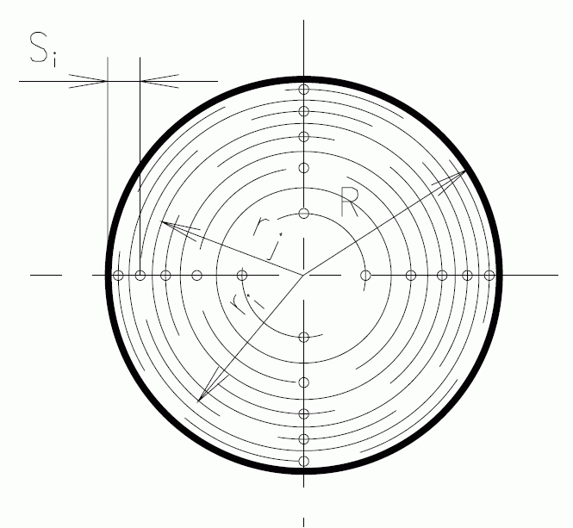
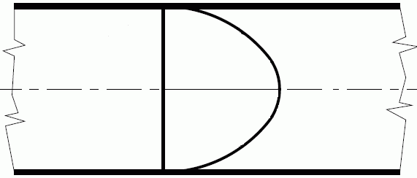
Volume flow rate / based on velocity measurements II.
Circular cross-sections, 10 point (6 point) method
The velocity profile is assumed to be a n^{nd} order function
Steady flow conditions
Based on Pitot-static (Prandtl) tube measurements of the dynamic pressure
This is a standardized procedure, and the measurement points are given in
the standard (MSZ 21853/2):
S_{i}/D= 0.026, 0.082, 0.146, 0.226, 0.342, 0.658, 0.774, 0.854, 0.918, 0.974
Notes:
25

Slide 26
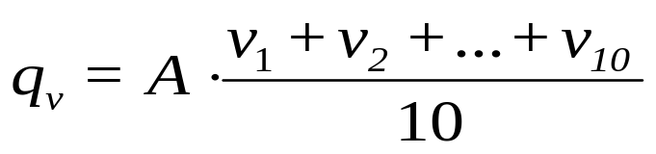
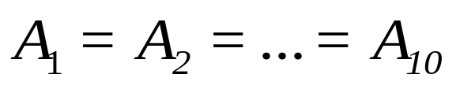
Volume flow rate / based on velocity measurements III.
Circular cross-sections, 10 point (6 point) method
Assumptions:
The advantage of this method, as compared to methods based on flow contraction, is that the flow is not disturbed greatly, and therefore the operation point of the system is not altered, and it is easy to execute the measurements.
The disadvantage is that the error can be much larger with this method. For long measurements it is also hard to keep the flow conditions constant. (10 points x 1.5 minutes = 15 minutes)
Notes:
26

Slide 27
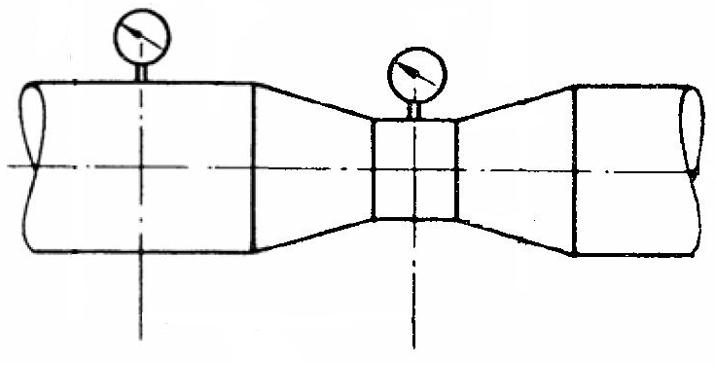
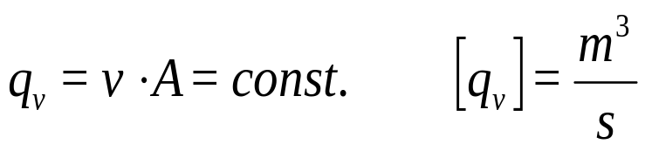
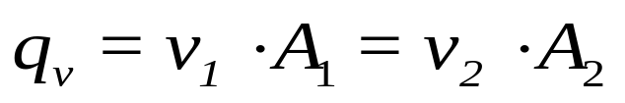



Volume flow rate / flow contraction methods
Venturi pipe
If compressibility is negligible
(ρ=constant):
A₁
A₂
H
p₁
p₂
Bernoulli equation
(ρ=const., U=const., no losses):
ρ_{f}
Δh
ρ_{m}
More info: Spurk & Aksel, Fluid Mechanics, Chapter 2.1. Conservation of Mass, Equation of Continuity, Chapter 4.2.2 Bernoulli’s equation
Notes:
27

Slide 28



Volume flow rate / flow contraction methods
Through flow orifice
Standard orifice - pressure difference
β = d/D Cross-section ratio
d [m] Diameter of the smallest cross-section
D [m] Diameter of the pipe upstream of the orifice
Re_{D} = Dv/ν Reynolds number’s basic equation
v [m/s] The average velocity in the pipe of diameter D
ν [m²/s] kinematic viscosity
p₁ [Pa] The pressure measured upstream of the orifice
p₂ [Pa] The pressure measured downstream of the orifice
Expansion number (ε=ε(β,τ,κ)~1 since for air, the change in pressure is small)
α Contraction ratio, α=(β,Re) (When used according to the standard)
    κ Heat capacity ratio or Isentropic expansion factor
τ=p₂/p₁ Pressure ratio
Notes:
28

Slide 29



Volume flow rate / flow contraction methods
Inlet orifice (not standard)
Inlet orifice
Inlet cone
Notes:
29

Slide 30


Comparison of volume flow rate measurement methods

Slide 31
Measurement midterm info
4 tasks:
-dimension conversion
-theory
-2 calculations
pass from 50%
Sample tests on the webpage

