Slide 1


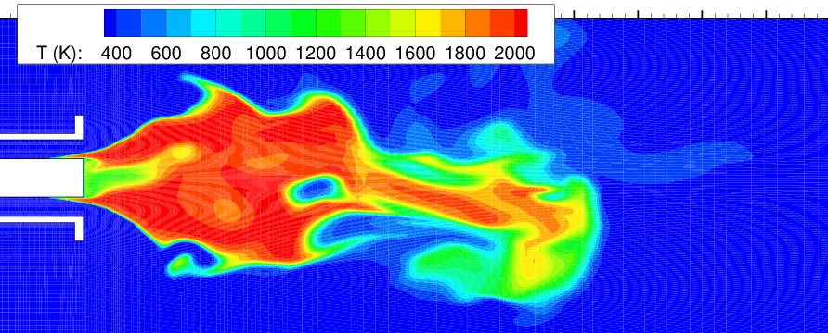
Reaction flow modelling
(Laboratory)
Lecturer : Karoly Czader (czader@ara.bme.hu)

Slide 2
Contents
Species Transport Equation
Reaction kinetics and reaction rates
Finite-rate reaction models
Simulation of methane (CH₄) combustion

Slide 3
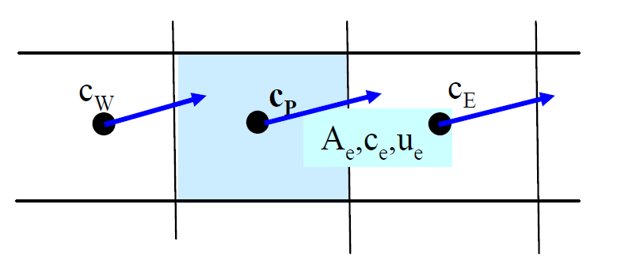
Species transport equation
Basic Formula:
Y_{i} = mass fraction of species „i” [kg/kg]
ρ = mixture density [kg/m³]
Convective term
Diffusive term
Source term
Local term
Reaction term
Diffusive term (Fick’s law II.):
*Soret-diffusion (Cross-effect)

Slide 4
Reaction Kinetics
The temporal change of the substances is of the interest
Arrhenius molar rate
of species i in reaction r [kmol*s⁻¹m⁻³]
Molecular-weight [kg/mol]
Irreversible reaction:
stoichiometric coefficient
for product / reactant
rate exponent
of product / reactant
third bodies on the reaction rate
molar concentration [kmol/m³]
forward rate constant

Slide 5
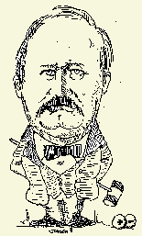
Reaction Kinetics
Example: H₂ + Cl₂ → 2HCl - 2nd-order reaction
Reaction rate constant (k):
Temperature dependent:
Extended Arrhenius - equation
ΔE_{a} – Activation energy (J/kmol)
β – Temperature exponent
A_{r} – Pre-exponential factor
3rd bodies on the reaction rate (Γ)
γ_{j,r} – ‘j’ body efficiency in reaction ‘r’
C_{j} – ‘j’ body concentration
Example: Ozone formation
M - Stabilize the ozone molecule by absorbing energy

Slide 6
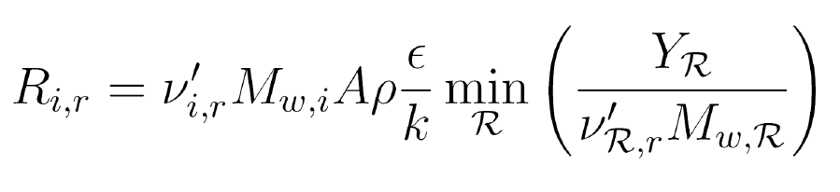
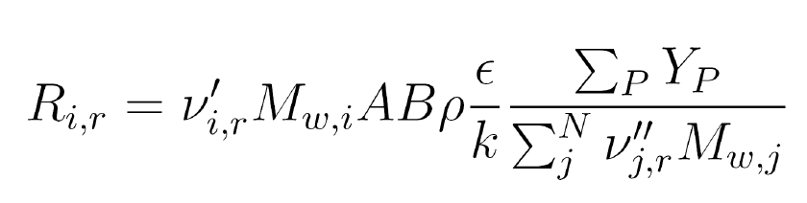
Finite-rate reaction models
Laminar finite rate model:
  R_{i} based on the molecular reaction kinetics (Arrhenius)
  No turbulence fluctuations
  Fine mesh and small timesteps are required for transient flows,
  otherwise the reaction rates are overpredicted.
Eddy-dissipation model
  R_{i} based on the turbulent mixing rate (no kinetic rate is calculated)
  Assumes that the turbulent timescale is larger than the reaction one
  (Da*>>1) : turbulent mixing rate - limited process
  Turbulent mixing rate associates with the timescale of eddies (τ=k/ε)
  Single or two step reaction mechanism can be modelled.
  R_{i} is equal to the smaller of the two expressions below:
*Da = Damkohler –number = τ (turbulence) / τ (reaction)

Slide 7
Finite-rate reaction models
Finite –rate/eddy-dissipation model
  The combination of the preceding models.
  The minor reaction rate is used depending on the timescales
Remarks:
Multi-step reactions (n>2) are not modelled properly
by the eddy-dissipation model
Problem: Every reaction has the same reaction rate derived from the turbulence
Eddy-Dissipation Concept model
  Extension of the Eddy-dissipation model
  Calculation of small scale eddies in which the various reactions occur
  Suitable for complex reactions (e.g. chain reactions,)
  Computationally expensive

Slide 8
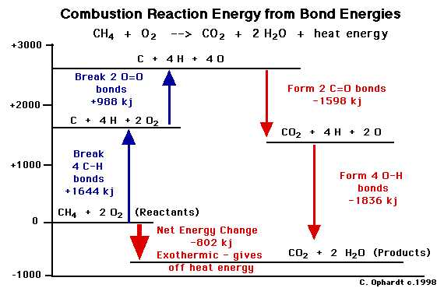
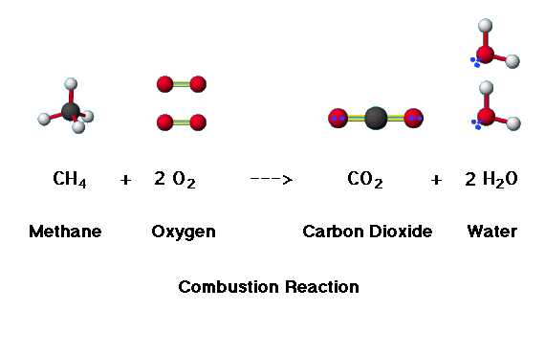
Methane combustion
Complete combustion:
Chain reaction process – multistep process

Slide 9
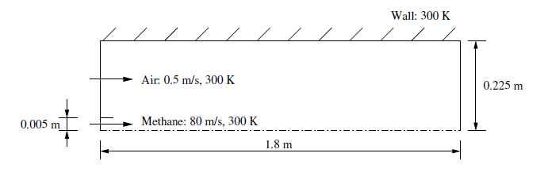
Problem description
Cylindrical combustor:
Re (based on methane jet diameter): ~ 5700 → turbulent mixing
Location of the mesh file:
Hallgatok/Czader/Fluent_Reactive_Flows/gascomb.msh

Slide 10
Model Setup
1. Scale Mesh → Check Mesh → Axissymmetric 2D
2. Models:
- Energy equation
- k-ε turbulence model (Default)
- Species transport model → Eddy-dissipation model
→ methane-air mixture
3. Materials:
- Specific Heat: Solution with Varying Heat Capacity
4. Boundary Conditions:
- Velocity-inlet-8 – „air-inlet”
v=0.5 m/s – Turbulent Intensity = 10% - Hydraulic diameter = 0.44
Species tab: 0.23 O₂ m/m
- Velocity-inlet-6 – „fuel-inlet”
v=80 m/s - Turbulent Intensity = 10% - Hydraulic diameter = 0.01
Species tab: 1 CH₄ m/m
- Pressure-outlet-9
Turbulent Intensity = 10% - Hydraulic diameter = 0.45
Species tab: 0.23 O₂ m/m
- wall-7 – „outer-wall”/ wall-2 – „nozzle” Thermal tab: Heat-flux = 0

Slide 11
Model Setup
5. Solution control:
- species underrelaxation: 0.95 for stabilizing the calculation in the initial period
6. Solution initialization
- Compute from: all zones
7. Save the model setup
- gascomb1.cas.gz
8. Running calculation (500 iteration)
9. Post-processing

