Slide 1

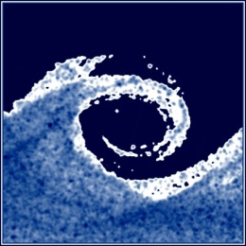


BUILDING AERODYNAMICS
BME GEÁT MW08
SAMPLE PROJECTS
Google drive folder to upload your data, report, presentation:
http://tinyurl.com/y8wa44h4
1

Slide 2
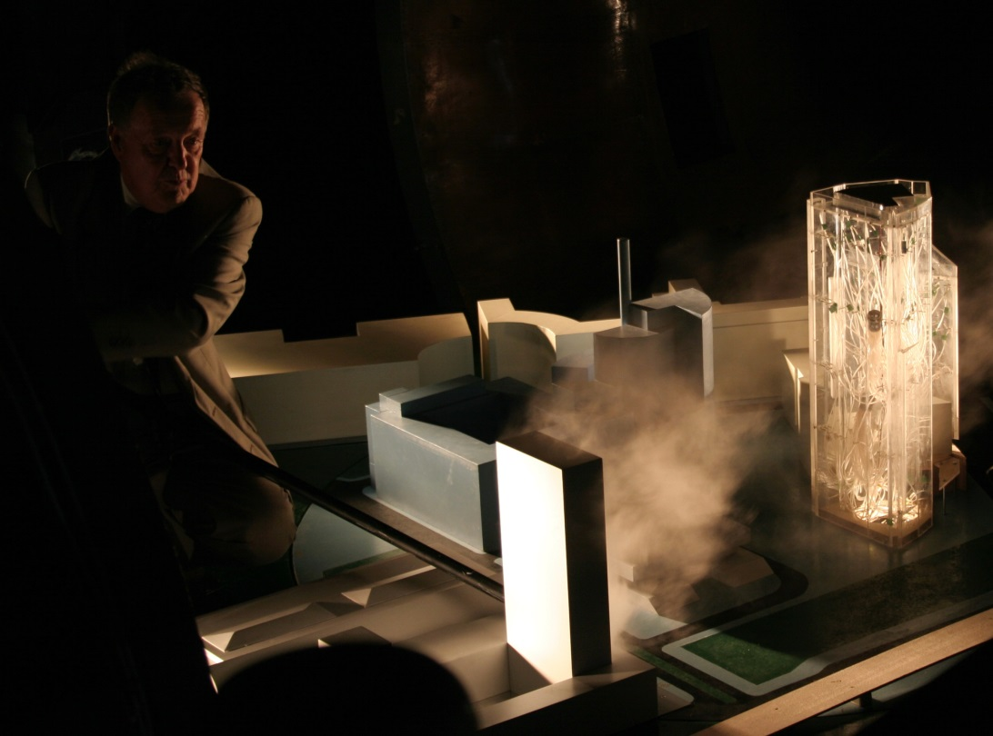
2) FLOW VISUALISATION VIDEO ON FLOW AND DISPERSION PHENOMENA AROUND BUILDINGS AND URBAN AREAS
Tasks
Explore flow visualization techniques.
Use existing and create some additional building models.
Use conventional lighting, oil smoke and a DSLR camera with video functionality.
You might use laser sheet for illumination as well.
You should visulaize known flow effects around low and tall buildings, urban areas.
Cut the video to a movie for the laboratory’s youtube channel, including English subtitles, given intro & outro
Try to create photographs as well!

Slide 3
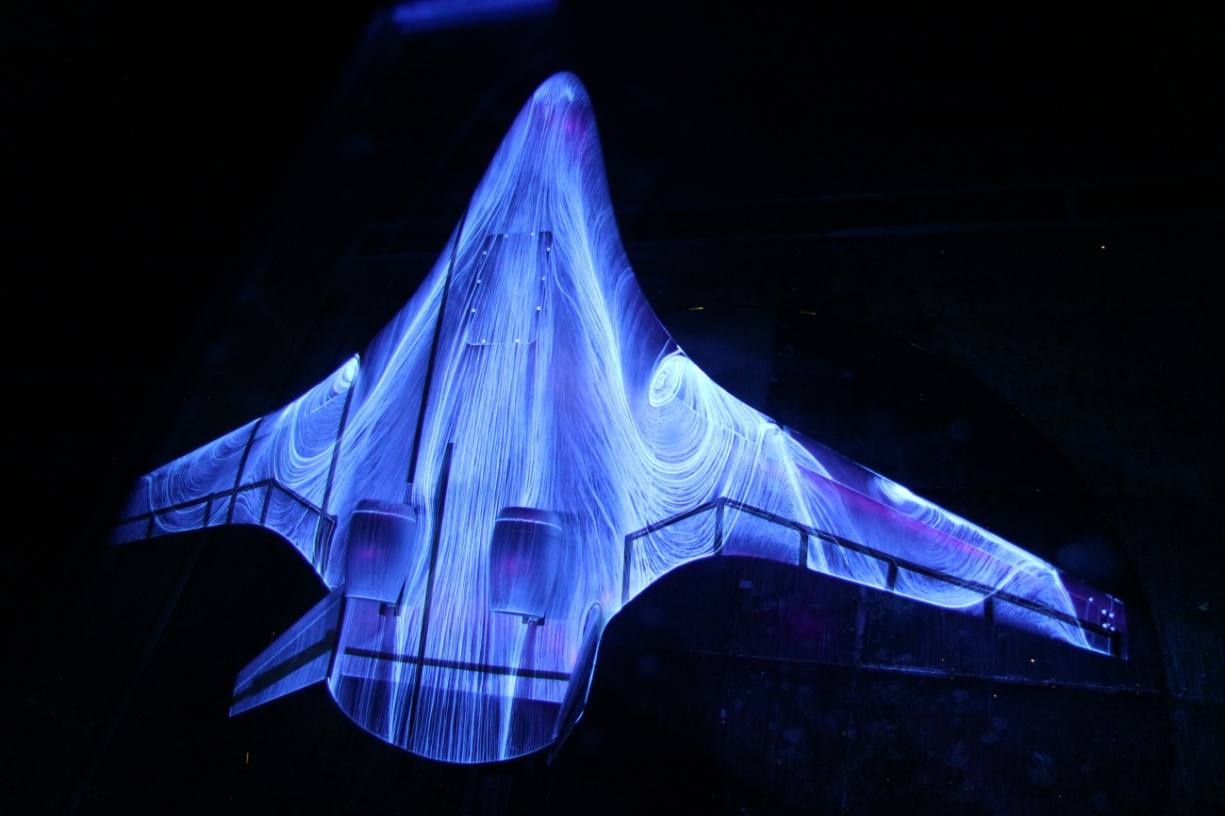
3) FLOW VISUALISATION using oil streak technique
Tasks
Read literature on oil streak visualization technique.
Experiment with the fluid in the NPL wind tunnel. Perform experiments on simple building shapes in the NPL wind tunnel. Document the perfect recipe.
If the technique is successful, go to the large wind tunnel. Use the existing model of a storehouse, a stadium.
Try to visualize the corner vortex on edge of cubic buildings.
Try to create stunning photographs from the results!
Taken

Slide 4
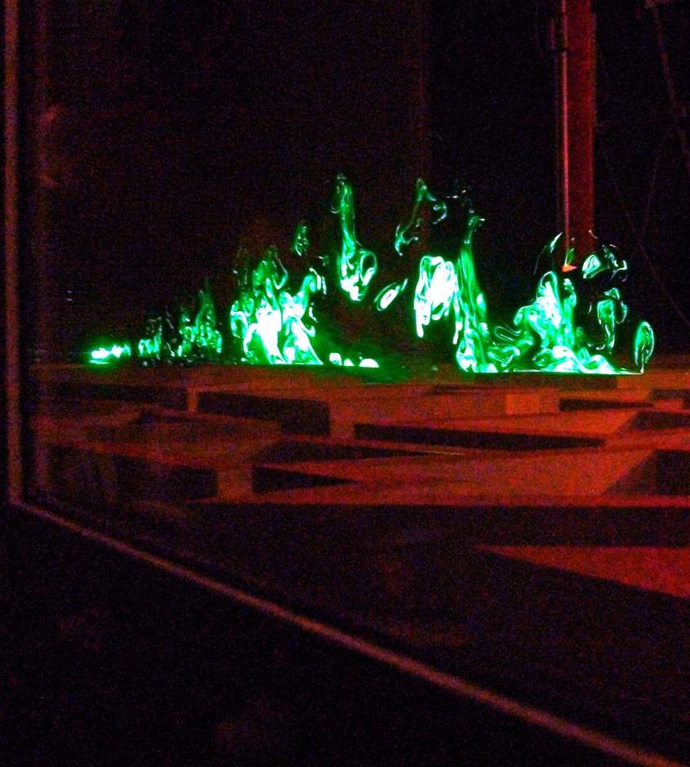
5) FLOW VISUALISATION LASER SHEET DEVELOPMENT USING SERIES OF LOW COST LASER DIODES
Tasks
Explore laser sheet generation techniques.
Design a laser sheet assembly for our large wind tunnel with at least 3 m leaser sheet width.
Laser power should be adjustable by turning off some of the diodes.
Select laser diodes, and calculate expected laser power.
Apply the unit in a flow visualisation in the large wind tunnel.
(Possible cooperation with Project 2!)
Taken

Slide 5
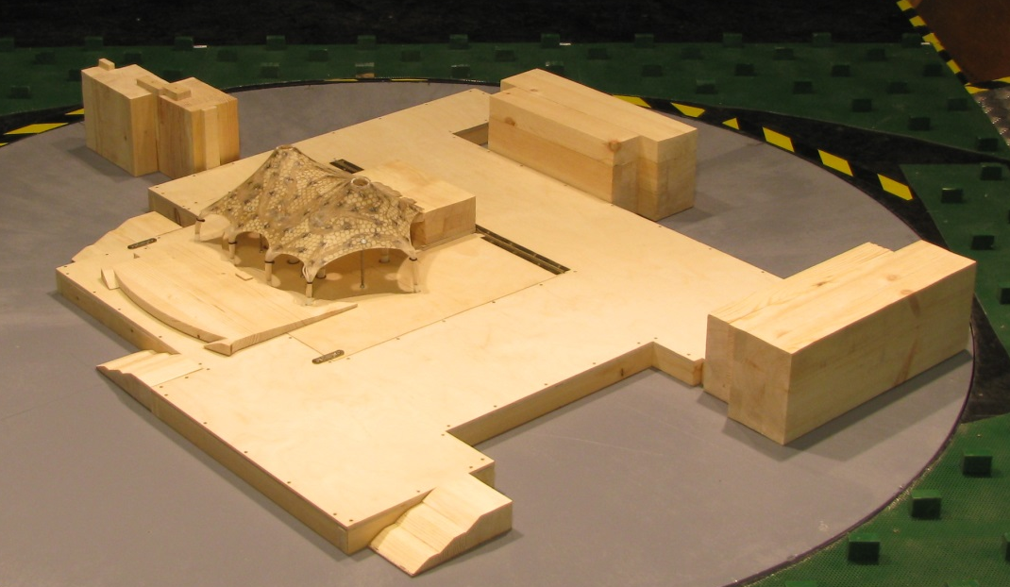
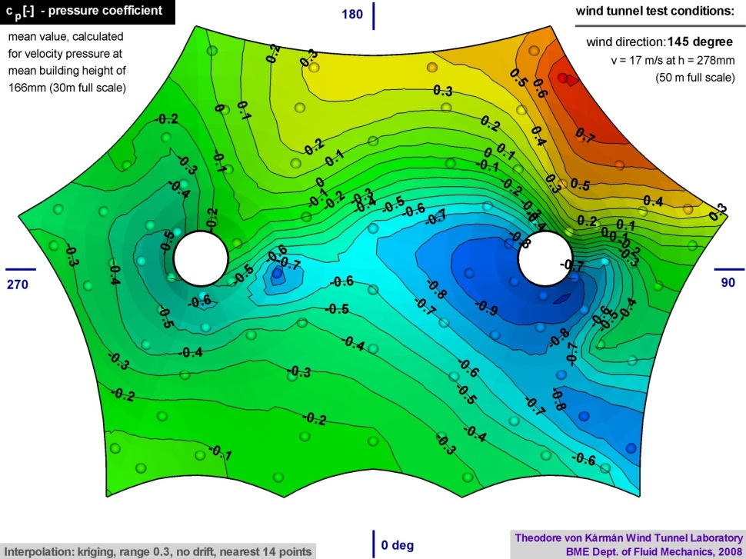
7) EXTREME VALUE ANALYSIS OF PRESSURE MEASUREMENTS
Tasks
Review the literature on wind pressure extreme value estimation methods
Apply the methods to estimate peak negative and positive pressures on pressure time series measured in a recent project
Write a Labview routine for pressure time series which outputs estimated
If possible visualize results.

Slide 6
1. Projects include a description of the problem and a literature review (books and journal articles) using library and EISZ resources (ScienceDirect, SpringerLink)*. Mention all major contributions at the topic investigated.
2. Measurement results and design data (CAD drawings) should be provided in an ordered format via e-mail to the supervisor. It is advisable to write a protocol from your measurements.
You should prepare a report of approx. 5-15 pages. (submission: 14th week)**
3. You should prepare a short Powerpoint presentation of approx. 15 min length about your project, or you should present the result of the project itself (e.g. a movie, series of photographs) (13th week)
Software access to be discussed separately with the groups
*To reach these services, register and login at eisz.om.hu (available only from BME IP addresses)
**No direct copy from other literature sources is allowed. Figures can be shown only with full reference to the original article/book. Preparation of own figures is encouraged.

